Slide 1
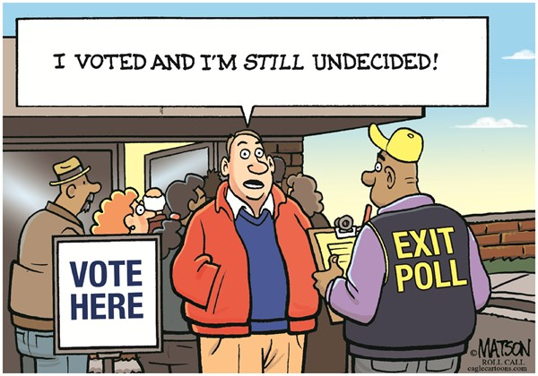
ELECTIONS AND REPRESENTATION
Chapter 8/9

Slide 2
SYLLABUS DOT POINT (EXAMINABLE MATERIAL)
Essential to the understanding of representation and justice is knowledge of:
the principles of fair elections
political participation
natural justice.

Slide 3
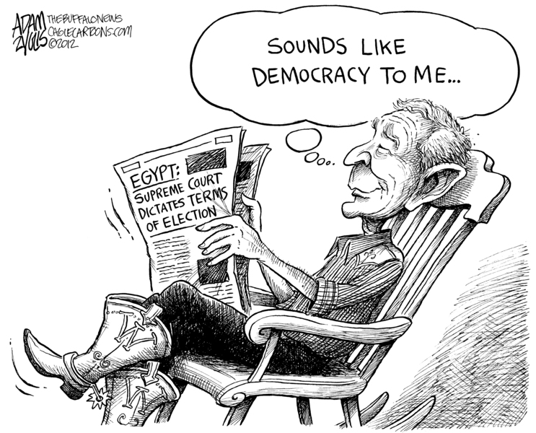
Functions of Democratic Elections
Providing a peaceful means of political change
Ensuring that there is democratic choice
Voters choose between alternative leaders, parties and policies
Voters can dismiss from office those groups whose policies they reject
Providing governments with a general right to rule = political legitimacy and a specific mandate to carry out their policies
Creating accountability to the people of political representatives in general and governments in particular
Providing a basis for the duty of citizens to uphold the law
Laws have legal authority because they are passed by freely elected government

Slide 4
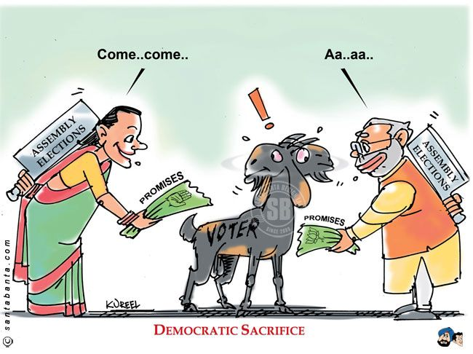
Democratic Electoral Principles
A free and equal vote
One vote one person / one vote one value = relative equality in the value of each vote
Electoral procedures and systems MUST encourage MAXIMUM PARTICIPATION by citizens
A vote without pressure
Citizens must exercise their vote freely – they should not be coerced/bullied into choosing a particular candidate
Secret ballot – adopted by AUS colonies 1800s = to ensure that people could always exercise a free choice at the ballot box
Freedom of information
Democratic choice must be based on the existence of fundamental political freedoms
E.g.: Freedom of speech; Freedom of Assembly; Free media

Slide 5
Democratic Electoral Principles
An extensive right to stand for office
Elections must provide genuine choice therefore there must be wide opportunity to run for political office
A predictable pattern of elections
Elections must be held regularly and reasonably frequently according to a set pattern
Elections must be independently administered

Slide 6
Eligibility
1900s: women gained full rights of participation in Australian elections
SA & WA once again paving the way
The Australian Constitution sets few limitations on the right to stand for Federal Parliament, reflecting similar freedom at state level
Section 44: It allows any Australian citizen with voting rights to become a Senator or MHR, as long as they…

Slide 7
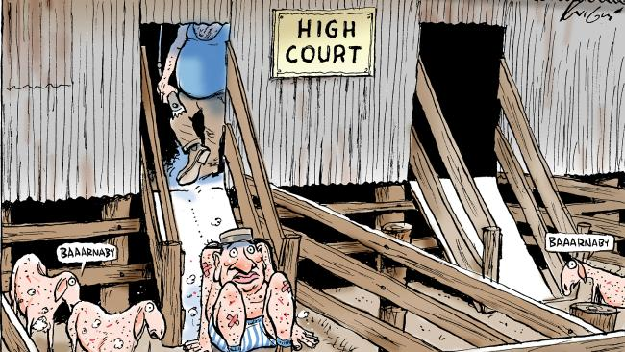
1. Are not a citizen of a foreign country
Notes:
Former Greens Senators Scott Ludlam and Larissa Waters
Greens leader Richard Di Natale (middle)

Slide 8

2. Have not been convicted of an offence that carries a sentence of one year or longer
Notes:
Larceny = theft of personal property

Slide 9
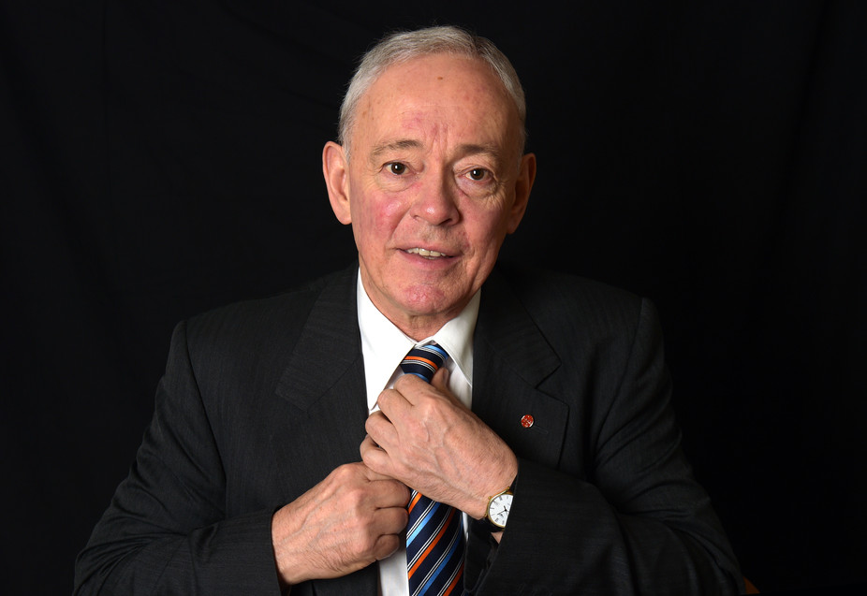
3. Are not an undischarged bankrupt

Slide 10
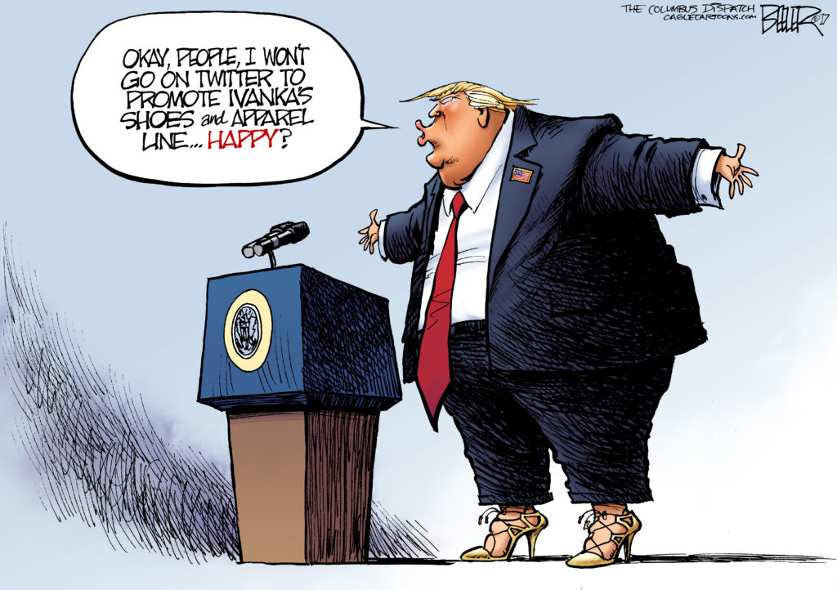
4. Are not a government employee or a contractor to the government (and thus would have a conflict of interest)
Notes:
Being employed by the government
Notable case: Phil Cleary

Slide 11

Eligibility
Section 34 of the Constitution also allows Federal Parliament to change the minimum age for a person to be a member of the Federal Parliament.
Originally it was 21 years old but now the minimum age is 18…any takers?

Slide 12

https://www.aec.gov.au/

Slide 13
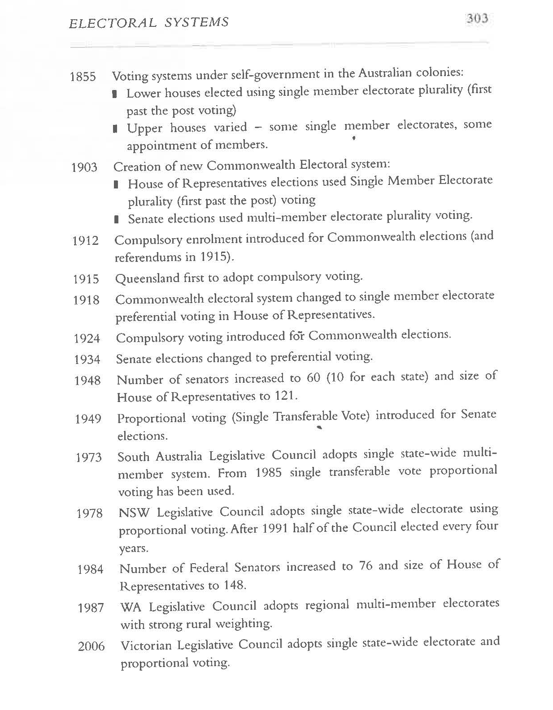
Young but good:
http://www.abc.net.au/btn/story/s4464749.htm

Slide 14
1984 electoral reforms
Hawke introduced a number of reforms that took place in 1984 election:
Increase in number of HoR seats from 125 to 148
Increase in the number of Senators to 12 (nexus clause), total of 76 - this increased ability of minor parties and independents to win
Reduction of the allowable variation in the size of the HoR seats from 20 to 10%
Extension on compulsory voting to Indigenous Australians
Introduction of Group Ticket Voting for the Senate (and party identification on ballet papers)
Proposed Reforms:
Relatively little changes except to the size of the Houses, potential reforms include:
Replacing proportional voting in the Senate
Adopting voluntary voting
Adoption of partial proportional voting for the HoR (50% electorates, 50% proportional)
Reducing the 6 year terms in Senate

Slide 15
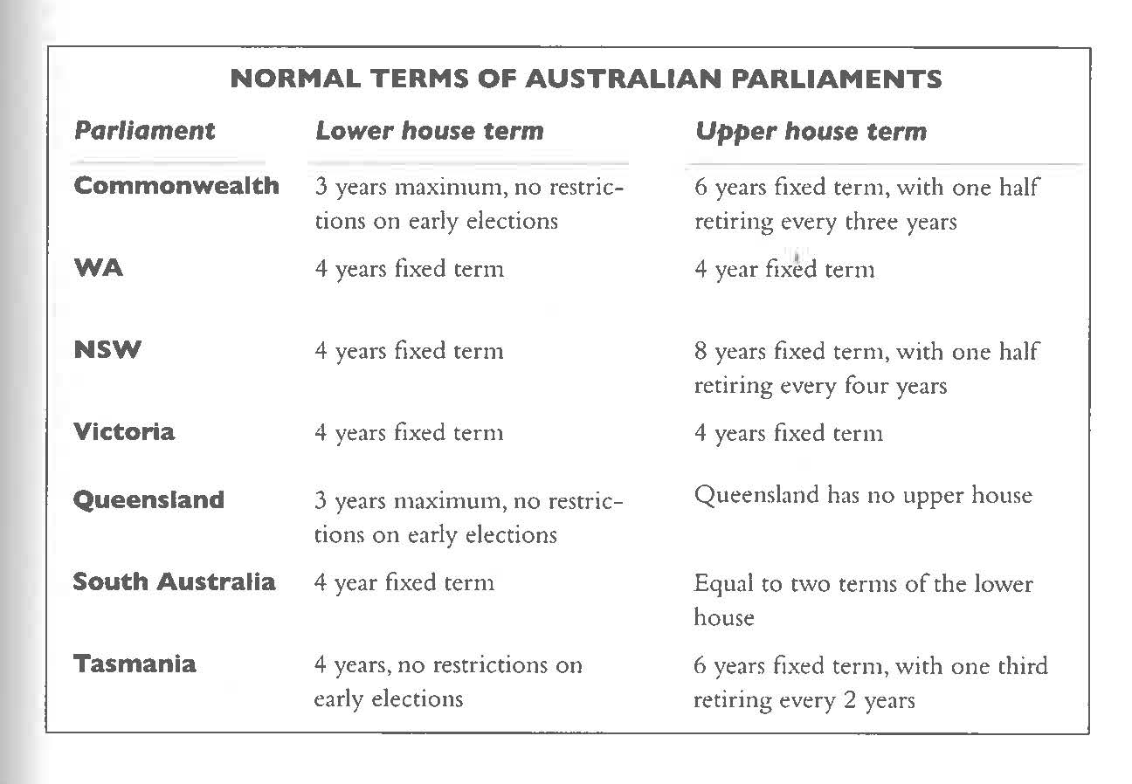
Timing of Elections
Fixed Terms vs.
Maximum Terms
Fixed terms require a new election is held after a specified period of time or even on specified date
Maximum terms allow governments to call early elections (go to polls before full term has been served)

Slide 16
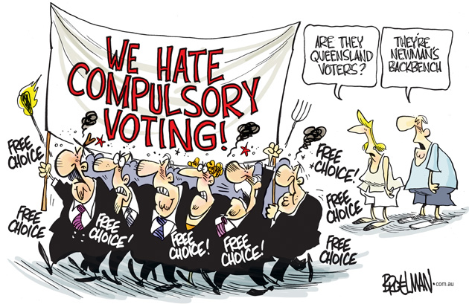
Compulsory Voting: Arguments for & against

Slide 17
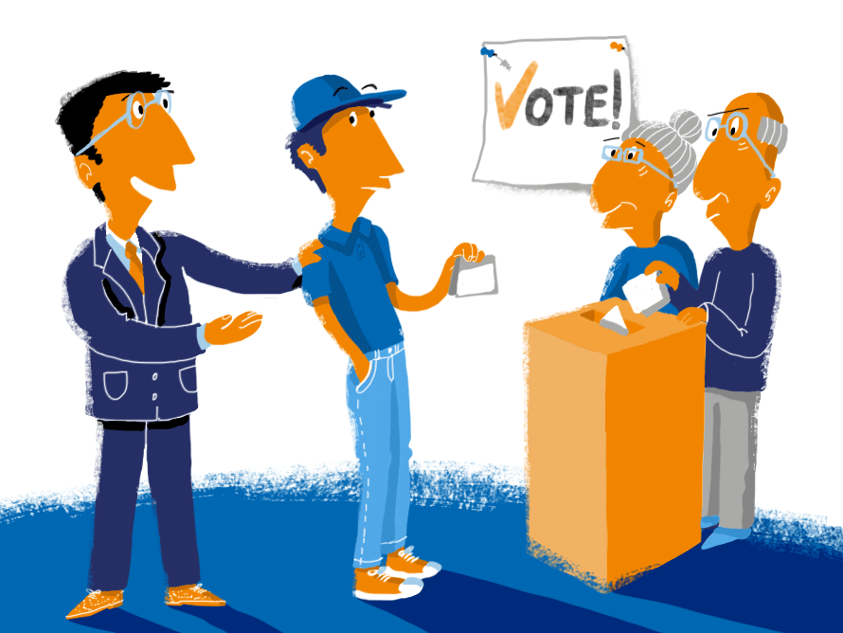
HISTORY
History of compulsory voting in Australia:
Compulsory enrolment for federal elections was introduced in 1912
Compulsory voting for state elections was introduced in Queensland in 1915
Compulsory voting at federal elections was introduced in 1924.

Slide 18
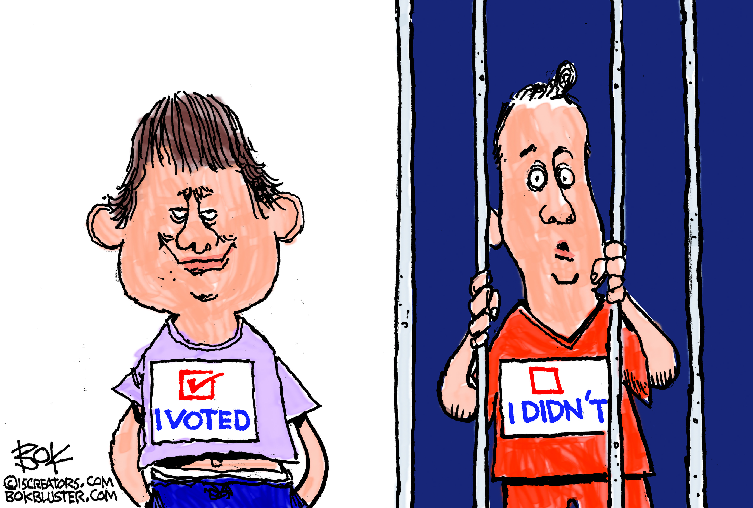
ARGUMENTS FOR
Voting is a civic duty comparable to other duties citizens perform e.g. taxation, compulsory education, jury duty
Teaches the benefits of political participation
Parliament reflects more accurately the "will of the electorate“
Governments must consider the total electorate in policy formulation and management
Candidates can concentrate their campaigning energies on issues rather than encouraging voters to attend the poll
The voter isn't actually compelled to vote for anyone because voting is by secret ballot.

Slide 19
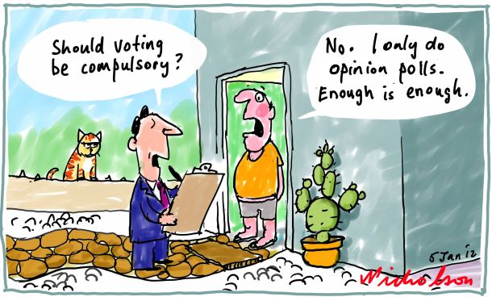
ARGUMENTS AGAINST
It is undemocratic to force people to vote – an infringement of liberty
The ill informed and those with little interest in politics are forced to the polls
It may increase the number of "donkey votes“
It may increase the number of informal votes
It increases the number of safe, single-member electorates – political parties then concentrate on the more marginal electorates
Resources must be allocated to determine whether those who failed to vote have "valid and sufficient" reasons.
https://www.youtube.com/watch?v=3y_xXZ7paVI

